Slide 1
Clustering assignment
Group 2

Slide 2
Work flow
01
Choose data and preprocessing
04
Perform Evaluations
02
05
Feature Engineering
Visualizations and Comparison
03
06
Clustering algorithms
Error Analysis

Slide 3
Work flow
Content (or a modified Distribute Slidesgo Content unless it has been expressly authorized by Slidesgo.
In our project we used general form of coding on our chosen data which we got it using requests library to get the web pages then we used beautifulSoup to extract the text
then we started the preprocessing removing the special characters, stop words and the unusual spaces as cleaning for the data de
Now we have our data prepared so we grouped our data by the name of the book and we have encoded the labels using LabelEncoder
We transformed it in many forms as a feature engineering like ( BOW, TF-IDF, BOW with n-gram, TF-IDF with n-gram, LDA, and word embedding)
We have trained our models after obtaining the pervious feature engineering ( K-means, Extraction maximization, and hierarchal clustering )
Then we have performed evaluation using ( Kappa, Coherence, Silhouette, and WSC with k-means) Slidesgo Content in an online or offline database or file.
- Offer Slidesgo templates (or modified versions of Slidesgo templates) for download.
- Acquire the copyright of Slidesgo Content.

Slide 4
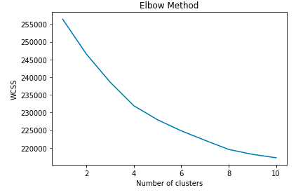
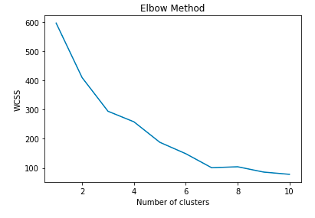
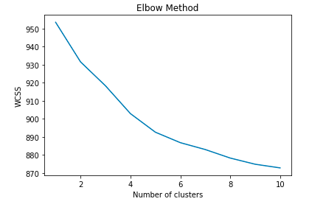
K-MEANS WITH BOW
65% V-Score
K-MEANS WITH LDA
69% V-Score
K-MEANS WITH TF-IDF
96% V-Score

Slide 5
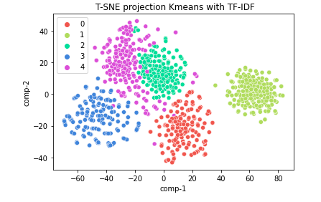
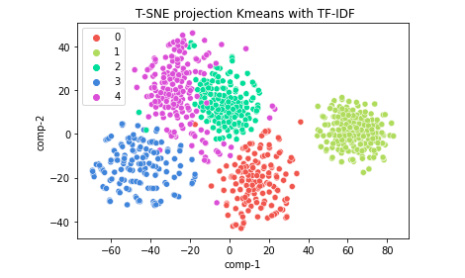
K-means with TF-IDF
With the highest V-score: 96%

Slide 6
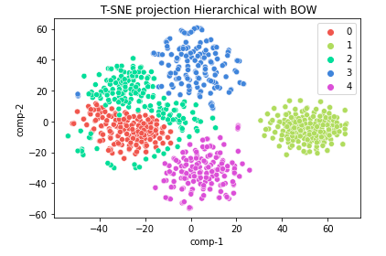
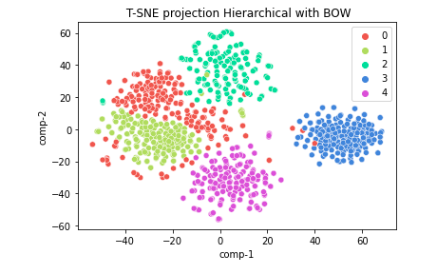
Hierarchical WITH BOW
Hierarchical with BOW- True Y
Hierarchical with BOW- Yhat
With the highest V-score: 94%

Slide 7
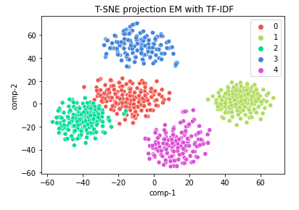
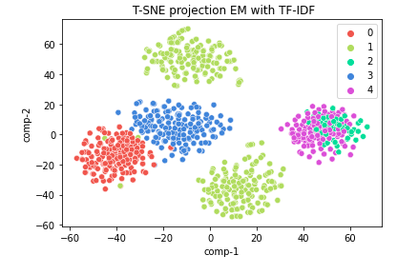
EM with PCA and TF-IDF
Y-actual
Y-hat
With the highest V-score: 85%

Slide 8
Mapping outputs
01
02
We have done mapping function to help in mapping the outputs from the clusters to our actual groups
Y- actual
Y- hat

Slide 9
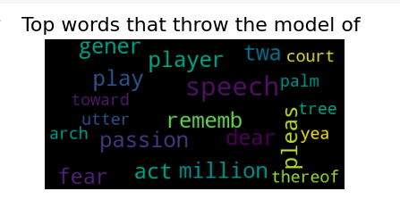
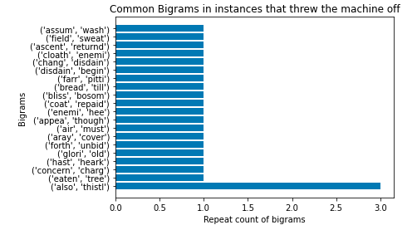
Our champion model is: k-means with tf-idf
the silhouette score is : 0.03 the v_measure score is : 0.96 the cohen kappa score is : 0.98
Error Analysis

Slide 10
THANK YOU!

